Slide 1
University of Asia Pacific Artificial Intelligence and Expert Systems
CSE 404
Project - 1
Implementation of a small address Map using A* Search Algorithm

Slide 2
PROBLEM DESCRIPTION
Create a graph of the area with nodes representing locations and edges representing routes between locations using google maps.
Assign weights to the edges based on factors such as distance, traffic, road conditions, etc.
Use the A* search algorithm with heuristic functions to find the shortest path from the starting node (home) to the destination node (University of Asia Pacific).
Implement the algorithm in code using a programming language such as Python, Java or any language.
Test the algorithm with sample inputs and fine-tune as necessary

Slide 3
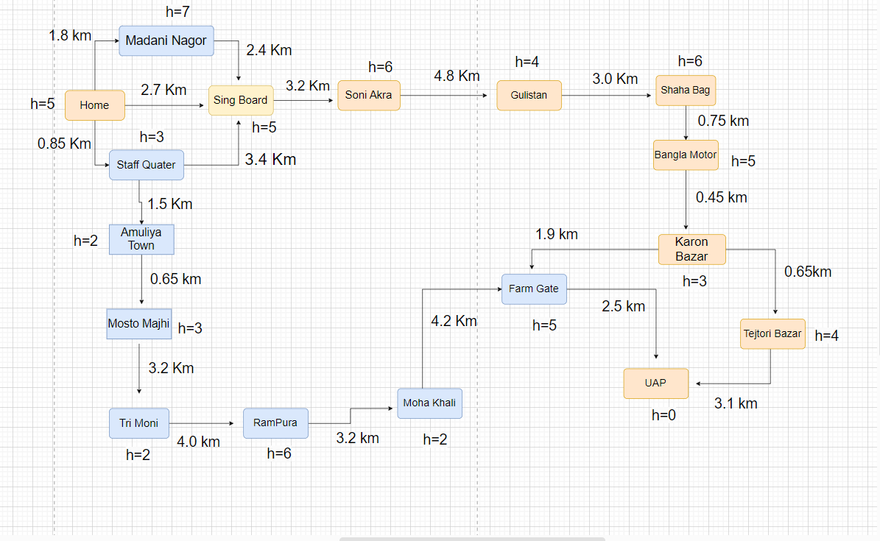
PATH GRAPH

Slide 4
NODES
Location Name | Latitude, Longitude
Home | 23.698172, 90.508396
madani nagor | 23.69721222197322, 90.50219265068066
sing board | 23.69383252677157, 90.48133311411327
soni akra | 23.70267925598862, 90.45042872427254
Gulistan | 23.725247432011304, 90.41187467116401
sha bag | 23.738441330255814, 90.39566599120757
bangla motor | 23.746967214172802, 90.39493154011586
karon bazar | 23.750184202676092, 90.39324059230391

Slide 5
Farmgate | 23.758506870657218, 90.38990857169617
Tejtori bazar | 23.75636484308535, 90.39248523488524
uap | 23.754894602408545, 90.38954351205821
Staf Quater | 23.775451114216672, 90.40509498322265
Amuliya town | 23.73324322853873, 90.4847539255497
Mosto majhi | 23.73911634730412, 90.48085935806495
Tri moni | 23.75454932325002, 90.4501598390421
Rampura | 23.761127914281143, 90.41932194089439
Mohakhali | 23.77318443242795, 90.4009900948624

Slide 6
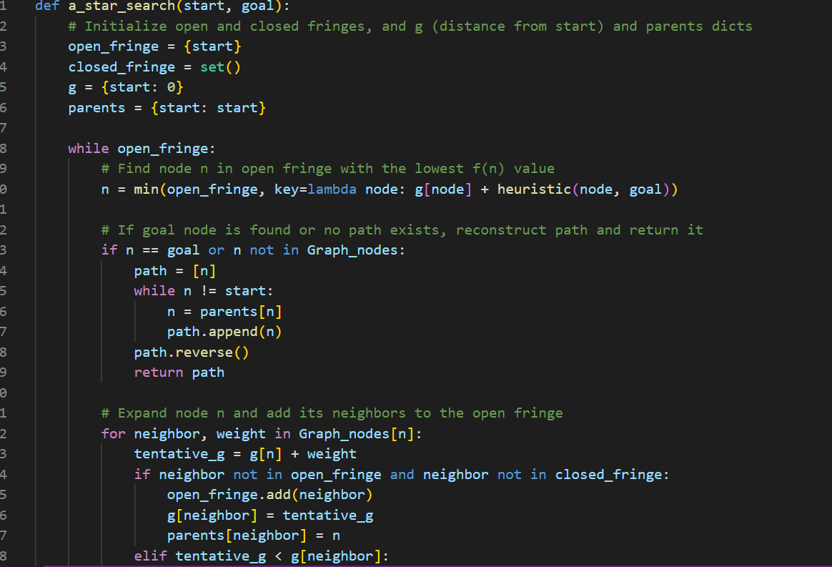
IMPLEMENTATION

Slide 7
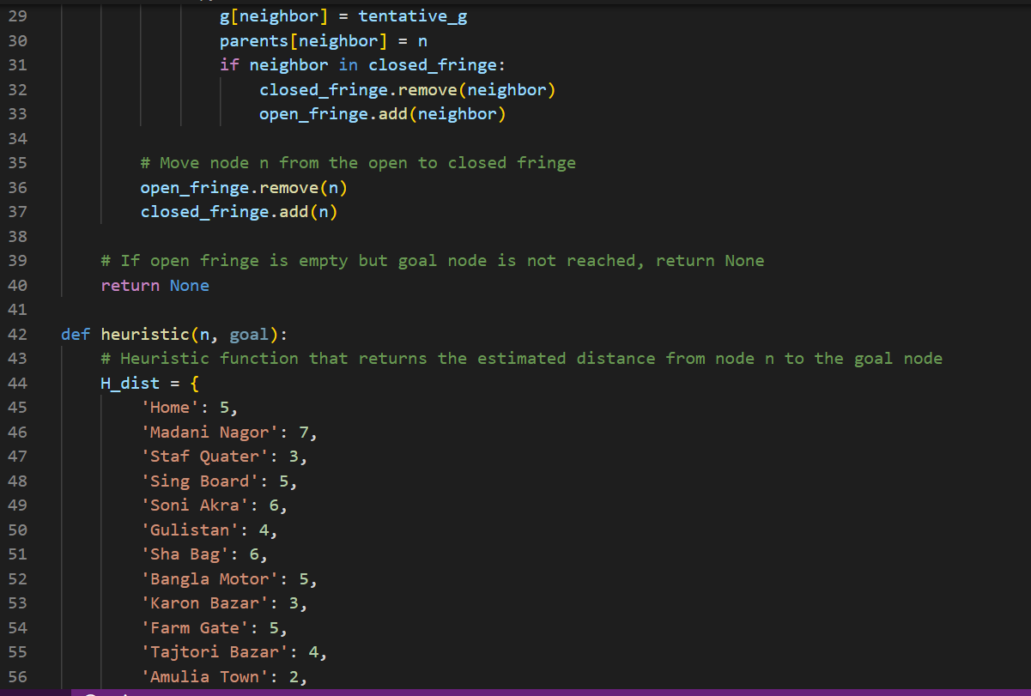

Slide 8
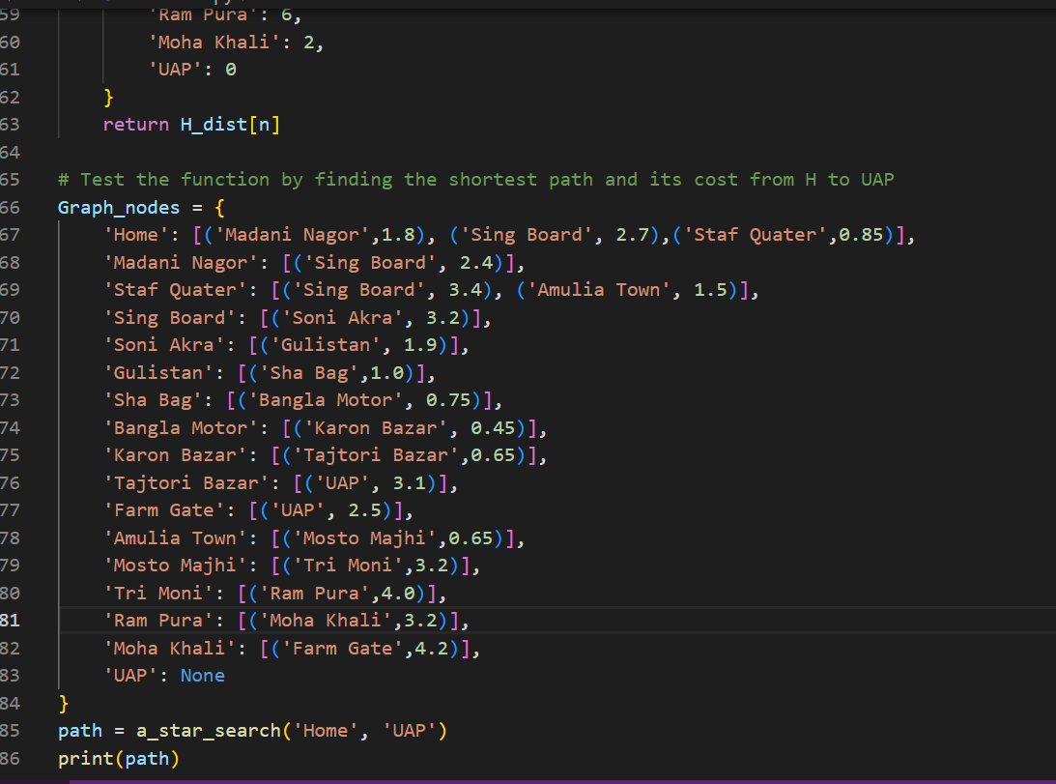

Slide 9
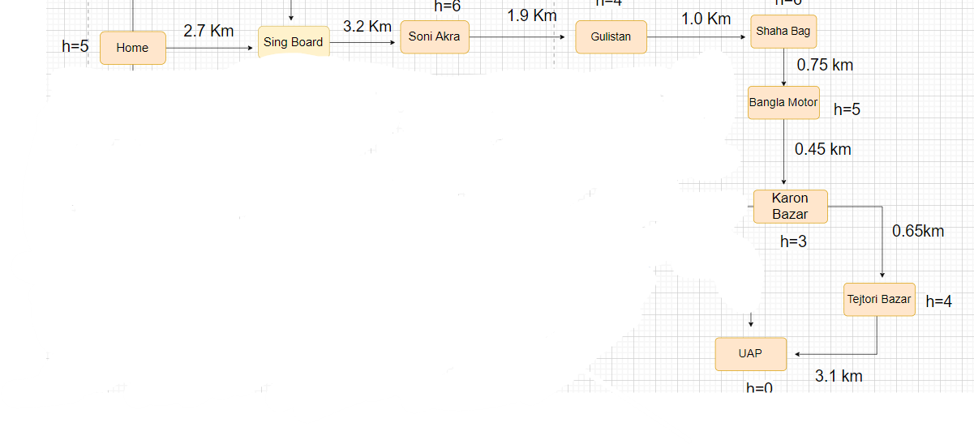
OUTPUT
['Home', 'Sing Board', 'Soni Akra', 'Gulistan', 'Sha Bag', 'Bangla Motor', 'Karon Bazar', 'Tajtori Bazar', 'UAP‘

Slide 10
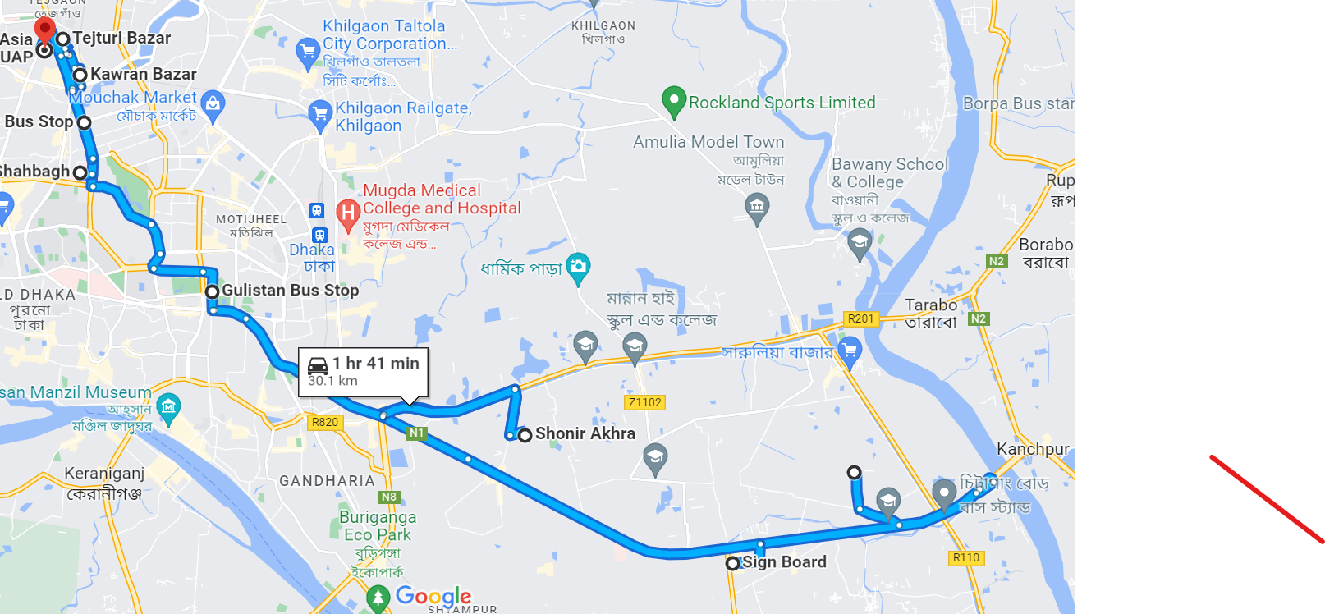
GOOGLE MAP PATH

Slide 11
THANK YOU

